Slide 1
Routing Protocols in MANETs
CS290F
Winter 2005

Slide 2
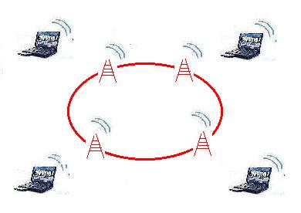
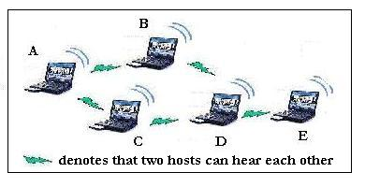
What is a MANET
Mobile nodes, wireless links
Infrastructure-less: by the nodes, …
Multi-hop routing: …, and for the nodes
Minimal administration: no hassles

Slide 3
What’s unique about a MANET ?
Moving nodes → ever changing topology
Wireless links
  → various and volatile link quality
Pervasive (cheap) devices
  → Power constraints
Security
  Confidentiality, other attacks

Slide 4
Challenges in MANET Routing
Need dynamic routing
  Frequent topological changes possible.
  Very different from dynamic routing in the Internet.
  Potential of network partitions.
Routing overhead must be kept minimal
  Wireless → low bandwidth
  Mobile → low power
  Minimize # of routing control messages
  Minimize routing state at each node

Slide 5
Other Challenges
Auto configuration issues
  Address assignment
  Service discovery
Security issues
  Ease of denial-of-service attack
  Misbehaving nodes difficult to identify
  Nodes can be easily compromised
New Applications/services
  Location based: Distribute some information to all nodes in a geographic area (geocast).
  Content based: Query all sensors that sensed something particular in the past hour.

Slide 6
MANET Protocol Zoo
Topology based routing
  Proactive approach, e.g., DSDV.
  Reactive approach, e.g., DSR, AODV, TORA.
  Hybrid approach, e.g., Cluster, ZRP.
Position based routing
  Location Services:
    DREAM, Quorum-based, GLS, Home zone etc.
  Forwarding Strategy:
    Greedy, GPSR, RDF, Hierarchical, etc.

Slide 7
Routing Protocols
Reactive (On-demand) protocols
  Discover routes when needed
  Source-initiated route discovery
Proactive protocols
  Traditional distributed shortest-path protocols
  Based on periodic updates. High routing overhead
Tradeoff
  State maintenance traffic vs. route discovery traffic
  Route via maintained route vs. delay for route discovery

Slide 8
Reactive Routing
Key Goal: Reduction in routing overhead
  Useful when number of traffic sessions is much lower than the number of nodes.
No routing structure created a priori. Let the structure emerge in response to a need
Two key methods for route discovery
  source routing
  backward learning (similar to intra-AS routing)
Introduces delay

Slide 9
Reactive (on-demand) routing:
Routing only when needed
Advantages:
  eliminate periodic updates
  adaptive to network dynamics
Disadvantages:
  high flood-search overhead with
    mobility, distributed traffic
  high route acquisition latency
0
query(0)
reply(0)
1
query(0)
query(0)
3
reply(0)
query(0)
2
query(0)
4
query(0)
reply(0)
query(0)
5

Slide 10
Reactive Routing – Source initiated
Source floods the network with a route request packet when a route is required to a destination
  Flood is propagated outwards from the source
  Pure flooding = every node transmits the request only once
Destination replies to request
  Reply uses reversed path of route request
  sets up the forward path
Two key protocols: DSR and AODV

Slide 11
Dynamic Source Routing (DSR)
Cooperative nodes
Relatively small network diameter (5-10 hops)
Detectable packet error
Unidirectional or bidirectional link
Promiscuous mode (optional)

Slide 12
Route Discovery
RREQ FORMAT
B
Initiator ID
A-B-D-G
A-B-D-G
G
Initiator seq#
A-B-D-G
A-B
Target ID
A
D
A-B-D
Partial route
A
A-C-E
A
E
H
A-B-C
A-C-E
Route Request (RREQ)
A-C-E
C
A-C
A-B-C
F
Route Reply (RREP)
Route Discovery is issued with exponential back-off intervals.

Slide 13
Route Discovery: at source A
A need to send to G
Lookup Cache for route A to G
Route found?
Start Route Discovery Protocol
no
Buffer packet
Continue normal processing
yes
wait
yes
Write route in
packet header
Packet in buffer?
Route Discovery finished
Send packet to next-hop
no
done

Slide 14
Route Discovery: At an intermediate node
<src,id> in recently seen requests list?
Accept route request packet
Discard route request
yes
no
Host’s address already in patrial route
yes
Discard route request
Append myAddr to partial route
no
no
myAddr=target
Store <src,id> in list
yes
Send route reply packet
Broadcast packet
done

Slide 15
DSR - Route Discovery
Route Reply message containing path information is sent back to the source either by
  the destination, or
  intermediate nodes that have a route to the destination
  Reverse the order of the route record, and include it in Route Reply.
  Unicast, source routing
Each node maintains a Route Cache which records routes it has learned and overheard over time

Slide 16
Route Maintenance
Route maintenance performed only while route is in use
Error detection:
  Monitors the validity of existing routes by passively listening to data packets transmitted at neighboring nodes
  Lower level acknowledgements
When problem detected, send Route Error packet to original sender to perform new route discovery
  Host detects the error and the host it was attempting;
  Route Error is sent back to the sender the packet – original src

Slide 17
Route Maintenance
B
RERR
G
RERR
D
G
A
Route Cache (A)
G: A, B, D, G G: A, C, E, H, G
F: B, C, F
E
H
C
F

Slide 18
A Summary of DSR
Entirely on-demand, potentially zero control message overhead
Trivially loop-free with source routing
Conceptually supports unidirectional links as well as bidirectional links
High packet delays/jitters associated with on-demand routing
Space overhead in packets and route caches
Promiscuous mode operations consume excessive amount of power

Slide 19
Break…
Then AODV

Slide 20
AODV Routing Protocol
S
E
F
A
C
G
D
B
AODV = Ad Hoc On-demand Distance Vector
Source floods route request in the network.
Reverse paths are formed when a node hears a route request.
Each node forwards the request only once (pure flooding).

Slide 21
AODV Route Discovery
S
E
F
A
C
G
D
B
Source floods route request in the network.
Each node forwards the request only once (pure flooding).

Slide 22
AODV Route Discovery
S
E
F
A
C
G
D
B
Uses hop-by-hop routing.
Each node forwards the request only once (pure flooding).
Reverse paths are formed when a node hears a route request.

Slide 23
AODV Route Discovery
S
E
F
A
C
G
D
B
Route reply forwarded via the reverse path.

Slide 24
AODV Route Discovery
S
E
F
A
C
G
D
B
Route reply is forwarded via the reverse path … thus forming the forward path.
The forward path is used to route data packets.

Slide 25
Route Expiry
S
E
F
A
C
G
D
B
Unused paths expire based on a timer.

Slide 26
AODV – Optimization
Useful optimization: An intermediate node with a route to D can reply to route request.
  Faster operation.
  Quenches route request flood.
Above optimization can cause loops in presence of link failures

Slide 27
AODV: Routing Loops
A
B
C
D
E
Assume, link C-D fails, and node A does not know about it (route error packet from C is lost).
C performs a route discovery for D.
Node A receives the route request (via path C-E-A)
Node A replies, since A knows a route to D via node B
Results in a loop: C-E-A-B-C

Slide 28
AODV: Routing Loops
A
B
C
D
E
Assume, the link C-D fails, and node A does not know about it (route error packet from C is lost).
C performs a route discovery for D.
Node A receives the route request (via path C-E-A)
Node A replies, since A knows a route to D via node B
Results in a loop: C-E-A-B-C

Slide 29
AODV: Use Sequence Numbers
Each node X maintains a sequence number
  acts as a time stamp
  incremented every time X sends any message)
Each route to X (at any node Y) also has X’s sequence number associated with it, which is Y’s latest knowledge of X’s sequence number.
Sequence number signifies ‘freshness’ of the route – higher the number, more up to date is the route.

Slide 30
Use of Sequence Numbers in AODV
S
Y
?
D
Dest seq. no. = 10
Has a route to D
with seq. no = 7
Seq. no. = 15
RREQ carries 10
Y does not reply, but
forwards the RREQ
Loop freedom: Intermediate node replies with a route (instead of forwarding request) only if it has a route with a higher associated sequence number.

Slide 31
Avoidance of Loop
DSN = Destination Sequence Number.
A
B
9
C
D
7
9
10
E
5
All DNS’s are for D
Link failure increments the DSN at C (now is 10).
If C needs route to D, RREQ carries the DSN (10).
A does not reply as its own DSN is less than 10.

Slide 32
Path Maintenance
3’
3’
1
3
1
Destination
Destination
Source
2
Source
2
4
4
Movement not along active path triggers no action
  If source moves, reinitiate route discovery
When destination or intermediate node moves
  upstream node of break broadcasts Route Error (RERR)
  RERR contains list of all destinations no longer reachable due to link break
  RERR propagated until node with no precursors for destination is reached

Slide 33
Summary: AODV
At most one route per destination maintained at each node
  After link break, all routes using the failed link are erased.
Expiration based on timeouts.
Use of sequence numbers to prevent loops.
Optimizations
  Routing tables instead of storing full routes.
  Control flooding (incrementally increase ‘region’)

Slide 34
Questions…
Other notes

Slide 35
Acknowledgements
DSR Slides:
  Yinzhe Yu (umn.edu)

Slide 36
Additional feature #1: Caching Overheard Routes
Node C Cache
E: C, D, E
E: C, D, E A: C, B, A
E: C, D, E A: C, B, A Z: C, X, Y, Z V: C, X, W, V
Node A Cache
E: A, B, C, D, E
A
B
C
D
E
V
W
X
Y
Z

Slide 37
Additional feature #2: RREP with Cached Routes
B
RERR
RERR
RREQ
RREQ
(! D-G)
D
G
A
Route Cache (A)
G: A, B, D, G
F: B, C, F
RREQ
RREQ
(! D-G)
E
H
RREQ
(! D-G)
G:A,C,E,H,G
RREP
C
F
Route Cache (C)
G: C, E, H, G
Route Cache (C)
G: C, E, D, G

Slide 38
Additional feature #3: Packet Salvage
B
RERR
G
RERR
D
G
Route Cache (D)
G: D, E, H, G
A
E
H
C
F
Caution: No double salvage allowed !!!

Slide 39
Proposed Routing Approaches
Conventional wired-type schemes (global routing, proactive):
  Distance Vector; Link State
Hierarchical (global routing) schemes:
  Fisheye, Hierarchical State Routing, Landmark Routing
On- Demand, reactive routing:
  Source routing; backward learning
Location Assisted routing (Geo-routing):
  DREAM, LAR etc

Slide 40
Conventional wired routing limitations
Distance Vector (eg, Bellman-Ford, DSDV):
  routing control O/H linearly increasing with net size
  convergence problems (count to infinity); potential loops
Link State (eg, OSPF):
  link update flooding O/H caused by frequent topology changes
CONVENTIONAL ROUTING DOES NOT SCALE TO SIZE AND MOBILITY

Slide 41
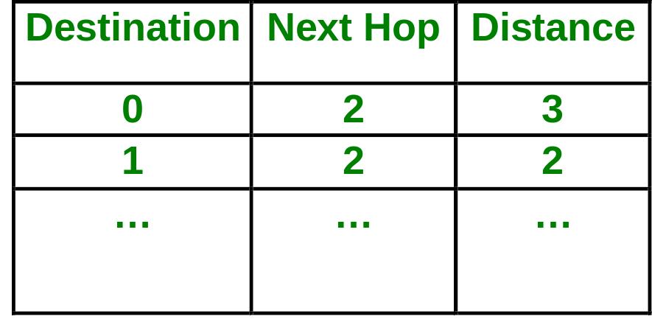
Distance Vector
0
Routing table at node 5 :
1
3
2
Tables grow linearly with # nodes
Control O/H grows with
mobility and size
4
5

Slide 42
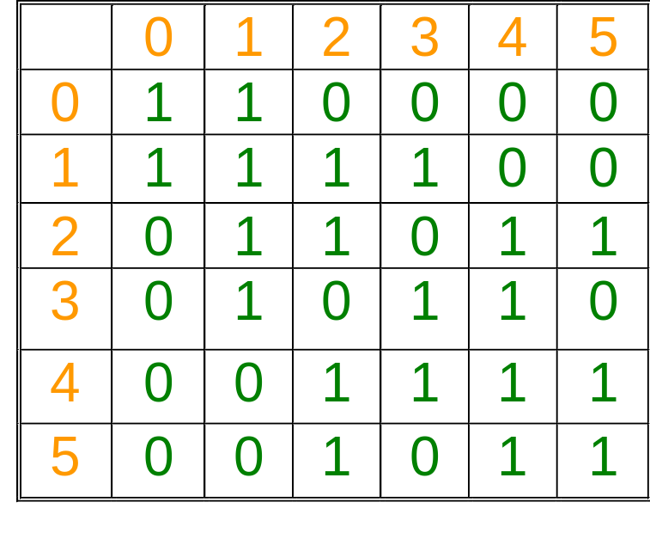
Link State Routing
At node 5, based on the link state packets, topology table is constructed:
Dijkstra’s Algorithm can then be used for the shortest path
0
{1}
{0,2,3}
1
3
{1,4}
{1,4,5}
2
4
{2,3,5}
5
{2,4}

Slide 43
Existing On-Demand Protocols
Dynamic Source Routing (DSR)
Associativity-Based Routing (ABR)
Ad-hoc On-demand Distance Vector (AODV)
Temporarily Ordered Routing Algorithm (TORA)
Zone Routing Protocol (ZRP)
Signal Stability Based Adaptive Routing (SSA)
On Demand Multicast Routing Protocol (ODMRP)
…

